Slide 1
Data Structures

Slide 2
Agenda
Deletion in Linked List
Find the Middle Element
Merge Two Sorted LL
Array vs Linked List
Reverse a LL
Intersection point in Y shaped LL
Detect Loop

Slide 3
Deletion in Linked List
Deletion:
Delete the complete Linked List
Delete from Head
Delete from End
Delete from nth position.

Slide 4
Deletion in Linked List

Slide 5
Find the Middle Element (second in case of even)

Slide 6
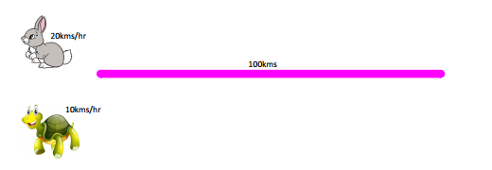
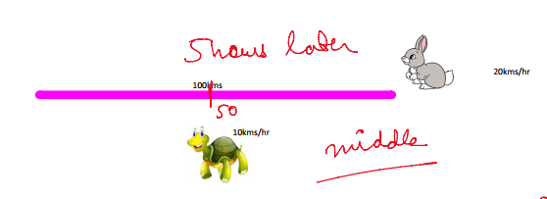
Find the Middle Element (second in case of even)

Slide 7
Find the Middle Element (second in case of even)

Slide 8
Problems:
https://practice.geeksforgeeks.org/problems/finding-middle-element-in-a-linked-list/1/
https://practice.geeksforgeeks.org/problems/nth-node-from-end-of-linked-list/1

Slide 9
Merge Two Sorted LL

Slide 10
Merge Two Sorted LL

Slide 11
Array vs Linked List
https://www.geeksforgeeks.org/linked-list-vs-array/
https://www.javatpoint.com/ds-array-vs-linked-list

Slide 12

Reverse a LL / k Groups

Slide 13
Reverse a LL / k Groups
H.W: Try Using Recursion

Slide 14
Intersection point in Y shaped LL

Slide 15
Detect Loop

Slide 16
THANK YOU

